Slide 1
The ins and outs of hip protectors to prevent fractures
Dr. Caitlin McArthur
Assistant Professor, Dalhousie University
GERAS Centre for Aging Research Scientist
InterRAI Fellow
Loop Fall Prevention Community of Practice
September 28, 2022

Slide 2
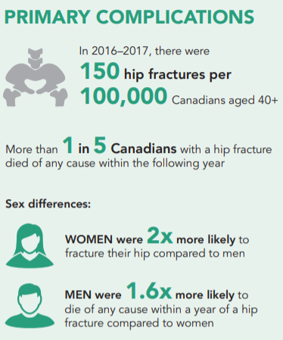
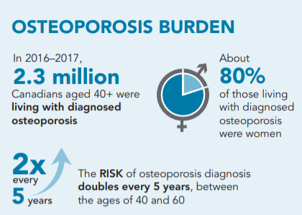
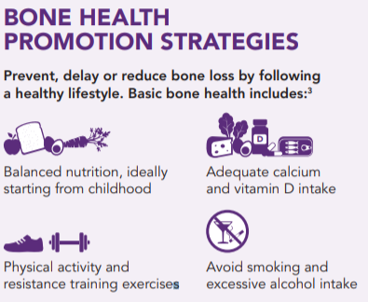
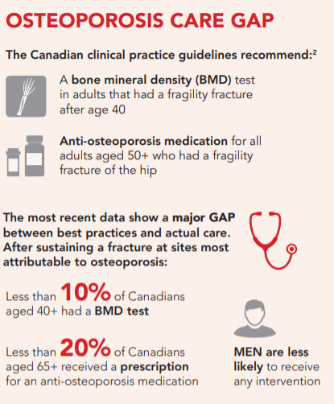

2021
OSTEOPOROSIS and RELATED FRACTURES in Canada
Osteoporosis occurs when bone tissue loss is faster than normal, causing it to become weak and fracture easily. Often people are not aware that they have osteoporosis until a fracture occurs. Common fragility fracture sites include forearm, hip, spine, upper arm and pelvis.
PHAC 2020. Osteoporosis And Related Fractures in Canada Report from the Canadian Chronic Disease Surveillance System
Notes:
In 2016-2017 there were 150 hip fractures per 100,000 Canadians 40 years and older. Fractures increase with age; forearm fractures were most common among Canadians aged 40-79 years and hip fractures were the most common among those 80 years and older. Women have higher fracture rates then men. About 25% of those with a hip fracture die of any cause in the following year. Fractures are the clinical consequence of osteoporosis. 80% of fractures are associated with low bone density and predict future fractures

Slide 3
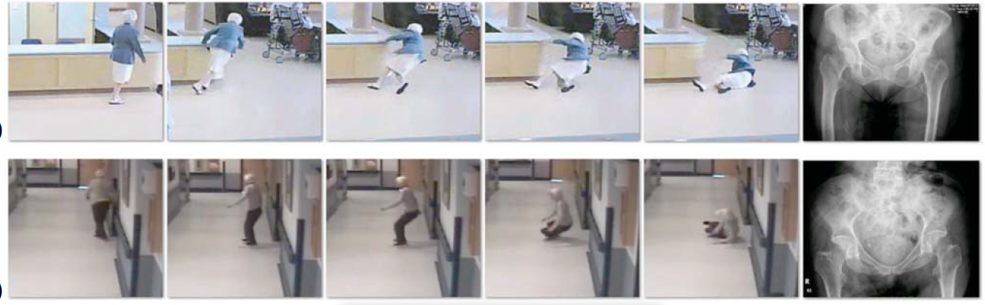
Biomechanics of falls
13
Often due to incorrect shifting, tripping
~ 1/3 of individuals who fall in LTC hit their heads
74% have some hand contact first but…not of sufficient strength to prevent falling
Robinovitch SN et al. Lancet. 2013; 381(9860):47-54.
Yang et al J Bone Miner Res 2020; 35(10):1914-1922

Slide 4

Biomechanics of falls
14
Robinovitch SN et al. Lancet. 2013; 381(9860):47-54.
Notes:
~ 1/3 of individuals who fall in LTC hit their heads
74% have some hand contact first but…not of sufficient strength to prevent falling

Slide 5
Fracture Prevention Strategies for Frail Older Adults
Bone-healthy diet and supplements
  Vitamin D supplementation (800-2000IU/day)
  Dietary calcium 1200 mg/day
  Calcium supplements ≤ 500mg/day if dietary cannot be met, considering person’s values and preferences
Healthy lifestyle
  Smoking avoidance and reduced alcohol intake
Medications
  Bone strengthening/ osteoporosis medications
Papaioannou et al. CMAJ, 2015, 187(15):1135-44.
McArthur et al. JAMDA, 2021; 22(8):1726-34
PHAC 2020. Osteoporosis And Related Fractures in Canada

Slide 6
Fracture Prevention Strategies for Frail Older Adults
Fall and fracture prevention strategies
  Exercise (balance, strength, and functioning training
  Medication reviews (Beer’s criteria or STOPP/START criteria
  Assessment of environmental hazards
  Use of assistive devices
  Management of urinary incontinence
  Hip protectors for those who are mobile considering resources and resident’s values and preferences
Papaioannou et al. CMAJ, 2015, 187(15):1135-44.
McArthur et al. JAMDA, 2021; 22(8):1726-34
PHAC 2020. Osteoporosis And Related Fractures in Canada Report from the Canadian Chronic Disease Surveillance System

Slide 7
What are hip protectors?
Personal protective equipment:
  Worn clothing or hip wraps with special padding on the sides to protect hips during a fall.
  Consist of two parts: impact protector and system that holds the protector in place.
  Some designed for one use, others for multiple impacts.
  Do not reduce risk of falling, but reduce risk of fracture.
  Recommended for those at high risk for falls and fractures.
Notes:
Hip protectors are clothing or wraps with special padding on the sides to protect your hips during a fall. Consist of two parts – impact protector and the system that keeps them in place. Impact protector is usually made of hard or soft plasticRecommended for those at high risk for falls and fractures. Some are designed to withstand one impact and then need to be replaced; others are designed to withstand several impacts.

Slide 8
How do hip protectors work?
Absorb the impact of a fall to protect the hip bone.
Cianferotti et al. Calcif Tissue Int. 2015; 97(1):1-11.
Notes:
A sideways fall produces a high-energy impact, which increases sixfold the risk of a hip fracture compared to a backward or a forward fall, even in young subjects. Figure shows a schematic representation of a sideways fall and consequent hip fracture (panel A) and potential preventive effect of a hip protector. The impact protector reduces the force on the hip during a fall - The particular design of hip protectors is aimed at decreasing and/or absorbing the impact of a sideways fall, ultimately preventing fractures of the proximal hip, encompassing intracapsular fractures
(i.e. at the site of femoral neck) and extracapsular fractures involving the trochanter

Slide 9
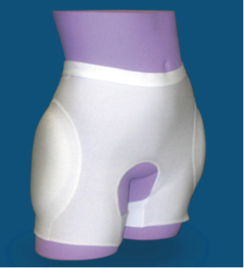
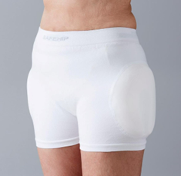
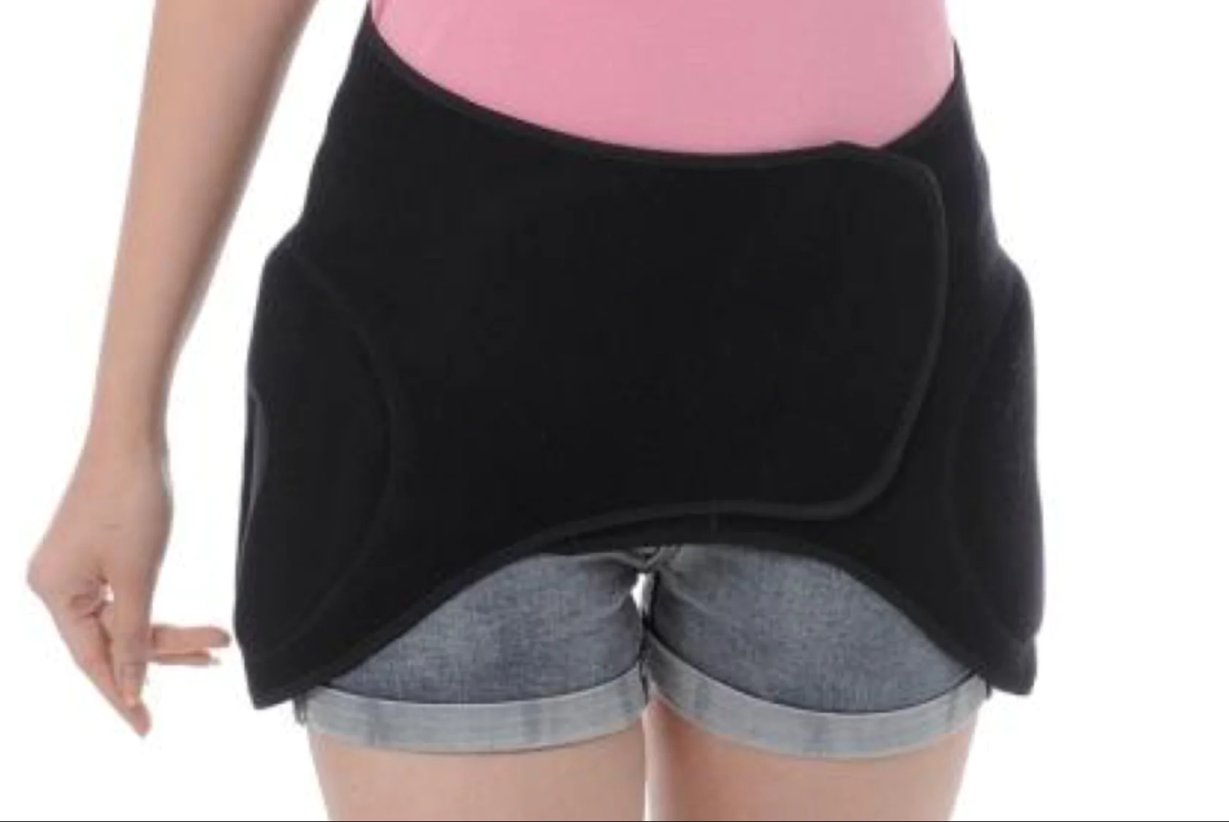
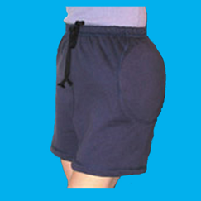
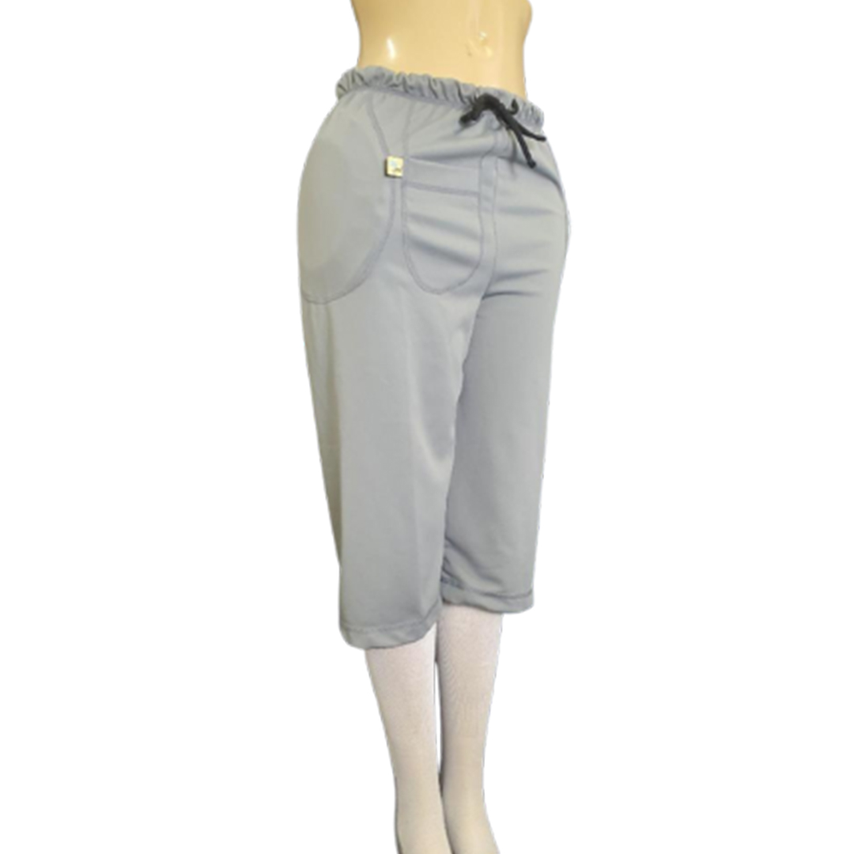
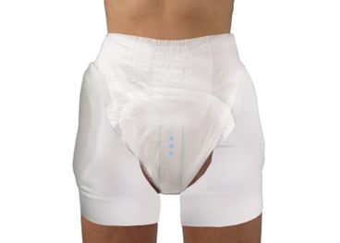
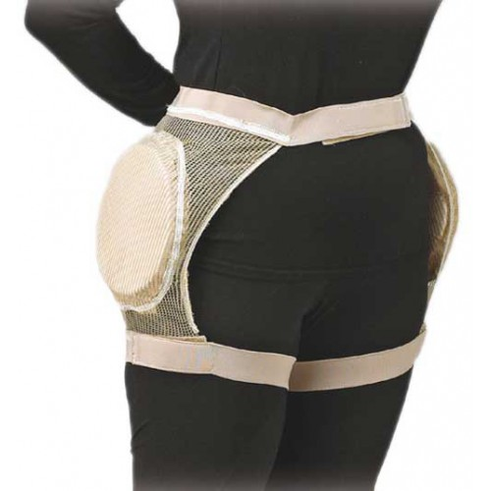
Types of hip protectors
Disposable/ stick on
Toileting friendly
Fashion friendly
Incontinence product-friendly
Notes:
Most hip protectors are undergarments worn under one’s usual clothing (e.g., underwear with protectors), others clothing (e.g., shorts, or pants) with protectors built in, or wraps with special padding on the sides that you wear on top of your clothing to protect your hips during a fall. Variety of products available – readily available on line. Looking online, cost varies depending on the type, and likely quality, from $45 to well over $200.

Slide 10
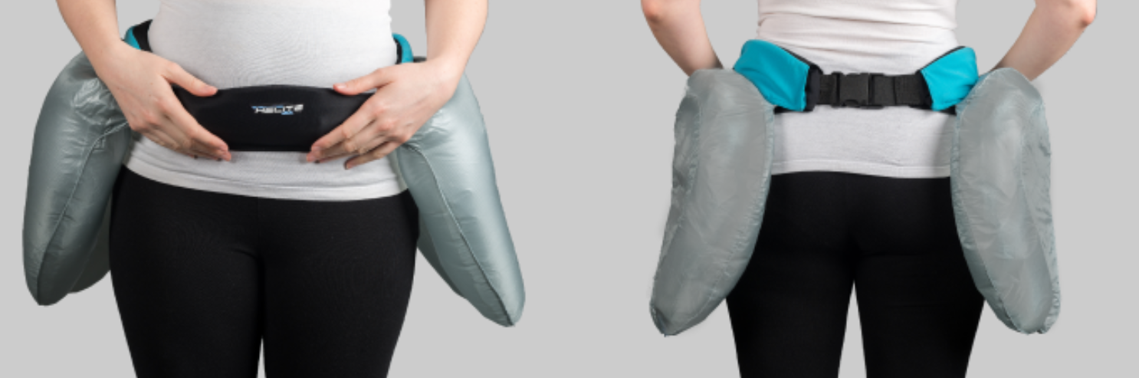
Latest trend: Hip protecting airbags
Inflate during a fall
May increase compliance with increased comfort
More research needed on effectiveness and comparative efficacy
Notes:
Next generation of hip protectors - Hip guard – contains an integrated electronic system that detects a fall within 0.2s and inflates on the side of the fall win .08s before the person hits the ground. No large scale RCTs testing. Inflatable airbag protection devices (patented), not yet tested in randomized trials, have the potential to significantly increase comfort, thus increasing overall compliance.
There’s a video of how it works at: Hip Guard - The Airbag Belt for seniors that protects the hips

Slide 11
Recommended design properties
Parameter | Recommendations
Basic design | Impact pendulum or drop tower
Effective (drop) mass | 28Kg (acceptable range: 22-33kg)
Effective pelvic stiffness | 47kN/m (acceptable range: 39-55kN.m)
Soft tissue covering | Polyethelene or polyurethane foam rubber
Minimal thickness of soft tissue covering over greater trochanter | 18mm
Impact velocity | 3.4 m/sb
Peak compressive force | 30-50ms
Time to peak compressive force | 30-50ms
Cianferotti et al. Calcif Tissue Int. 2015; 97(1):1-11.
Notes:
Hip protectors undergo standardized biomechanical laboratory testing in a preclinical setting in order to measure and optimize their biomechanical properties before studies in humans. The International Hip Protectors Research Group
(IHPRG) has developed evidence-based recommendations to properly test the biomechanical efficacy and performance of old and newly developed hip protectors. The primary objective of a hip protector should be the percentual
reduction in the ‘‘peak axial compressive force’’ applied to the femoral neck below a certain threshold known to cause hip fracture in the reference population (estimated 3472 N by studies on cadavers), achieved by blunting the stiffness of the trochanter and/or deflecting the force towards the surrounding soft tissue, thereby better absorbing the applied energy.

Slide 12
Secondary design properties
Ability to protect from falls other than from the side
Aesthetic characteristics
Durability
Skin tolerability
Elastic properties
Weight
Cost
Capacity to stay in place once positioned
Cianferotti et al. Calcif Tissue Int. 2015; 97(1):1-11.
Rabinovitch et al. Osteropor Int. 20:1977-88.
Notes:
Secondary objectives of hip protectors would be to protect from falls in different directions in addition to the side, from diverse type of forces (torsional and/or bending vs axial), suitable aesthetic characteristics, durability, skin tolerability and capacity to stay in place once positioned.

Slide 13
Impact protector construction
2 Broad Categories
Energy-absorbing
Energy-shunting
Hard plastic (polypropylene)
Energy absorbing: ‘crash-helmet like’ – rigid pads that spread the energy of the impact
Soft plastic (polyethylene)
Shock absorbing: soft pads that decrease the force of the impact
Cianferotti et al. Calcif Tissue Int. 2015; 97(1):1-11.
Blalock et al. Injury Prev. 2011;16:235-39.
Notes:
Primary aim is to reduce energy transmitted to the trochanter during a fall below the force causing a fracture. At the biomechanical level, hip protectors
can be divided into two broad categories. Energy absorbing hip protectors are designed to absorb the impact from a fall, whereas energy-shunting hip protectors are designed to shunt the force of impact away from the greater trochanter of the femur.
Hard plastic is energy absorbing: ‘crash-helmet like’ – rigid pads that spread the energy of the impact to the soft tissue of the thigh surrounding the hip.
Soft plastic is shock absorbing: decreases the force of the impact ultimately transmitted to the bone.

Slide 14
Hard vs soft: Which are better?
Very few comparative, conclusive analysis of clinical effectiveness
  Existing studies found wide variation in the force attenuation
  Those that cover greater trochanter provide greater force attenuation
Comparative effectiveness in different populations (LTC, community) is not clear
No evidence of comparative cost-effectiveness between brands
Proper fit and positioning is key regardless of type
CADTH Hip Protectors: Review of the Comparative Clinical and Cost-Effectiveness. 2015; www.cadth.ca
Cianferotti et al. Calcif Tissue Int. 2015; 97(1):1-11.
Laing et al. J Biomech. 2011; 44(15):2627-35.
Notes:
Laing et al – found that that there is wide variation in the force attenuation provided by currently marketed hip protectors when positioned correctly over the greater trochanter, and shows that a range of material and geometrical variables affect biomechanical effectiveness.

Slide 15

Hip Protector Fit
Should be comfortable and easy to put on and take off.
Should stay in place while walking, sitting, bending, and during a fall.
Should fit well to function properly.
Should not prevent independent dressing toileting, or use of incontinence products.
Should be positioned over the greater trochanter for maximum protection
www.CADTH.ca
Minns et al. Age Aging, 2007;36(2):140-144
Notes:
Positioning is key: It is important for the function of the hip protector that the pad element is positioned over the GT when the subject falls onto a surface such as the floor so as to provide the maximal protection by reducing the large forces transmitted to the femoral neck that lead to the fracture of the bone.

Slide 16
Proper positioning
Proper positioning over the greater trochanter is 6cm above the plane of the garment crotch on the torso model
Confirmed when compared with the greater trochanter position in vivo movement tests.
Minns et al. Age Aging, 2007;36(2):140-144
Notes:
Study comparing the location of the hip protector over the greater trochanter using ultrasound examinations on control and patients admitted with a fracture of the hip due to a fall. In these test subjects they identified a 12cm zone in which the hip protector should be positioned to prevent fracture. Image shows GT centre guide (hole) on a SafeHip garment used in the position study. Using this position, a study assessed the location of hard and soft shells over the greater trochanter.

Slide 17
Some hip protectors do not cover the greater trochanter (GT)
Hole represents the location of the GT
1 of 4 of the hard shell protectors does not cover the GT (#2), 1 is on the edge of the shell (#1)
2 of the 5 soft shell protectors do not cover the GT (#5, #6)
Minns et al. Age Aging, 2007;36(2):140-144
Notes:
Once they located this “zone” they then assessed 4 hard shell and 5 soft shell protectors to see if they fit within this “zone” over the greater trochanter. They found that three out of four
of the hard shell designs appear to cover the GT, in one design (first one on the first row) the GT centre appears close to the shell edge. Two of the soft pad designs appear not to cover the GT on the torso model.

Slide 18
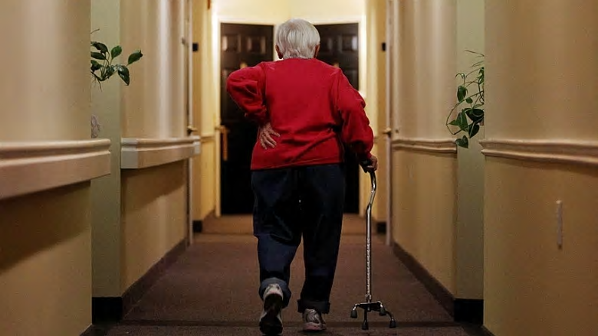
Hip protectors & flooring properties
Flooring RCT¹ in LTC found:
  Compliant flooring doesn’t increase risk/ rate of falls but it also does not reduce risk/rate of fall-related injuries.
  Not likely to cause harm, but no clear benefits.
  More research needed on design of safer living environments
Japanese study² studied hip protectors against various flooring materials (concrete, wood, tatami)
  Tatami (foam-based flooring) offered best force-attenuation effect
¹McKey et al., PLoS Med 2019:16:e1002843.
²Li et al. J Biomech 2013;46:1140-46.
Notes:
Some studies have looked at the role of various types of flooring in preventing falls and fractures. McKey’s RCT in LTC found that softer landing surfaces as provided by low-stiffness complaint flooring studied did not reduce the frequency of serious fall-related injuries, minor fall-related injuries, or falls among long-term care residents over 4 years.
Only one study (Japanese) has looked at the efficacy of hip protectors with various flooring properties ( concrete, wood and tatami (a foam-based – like the foam puzzle pieces used in kids playrooms): they found that soft protectors against tatami flooring offered the best force-attenuation effect.
Much more research is needed in this area.

Slide 19
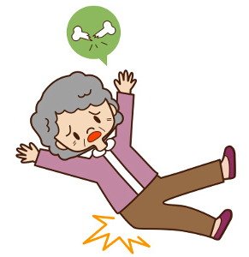
How effective are hip protectors in preventing fractures?
Cochrane review 2014
Residential care settings: 14 studies (N = 11,808)
  Moderate quality evidence
  Small reduction in hip fracture risk (RR = 0.82)
  11 fewer people per 1000 will fracture with hip protectors
  Small increase in pelvic fractures (RR = 1.27)
  1 more person per 1000 will have pelvic fracture with hip protectors
Santesso et al. Cochrane Database of Sys Rev. 2014;3: CD001255.
Notes:
Pooling of data from 14 studies (11,808 participants) conducted in nursing or residential care settings found moderate quality evidence for
a small reduction in hip fracture risk (risk ratio (RR) 0.82, 95% confidence interval (CI) 0.67 to 1.00) – residents are 18% less likely to experience a hip fracture when wearing hip protectors. The absolute effect is 11 fewer people (95% CI, from 20 fewer to 0) per 1000 having a hip fracture when provided with hip protectors.
Bottom line: For those in residential care, hip protectors:
probably slightly reduce the number of hip fractures. The evidence suggests that for every 1000 people wearing hip protectors 11 fewer will break a hip, but this could range from 20 fewer to none.
may slightly increase the small risk of a pelvic fracture.
probably have no effect on other breaks or on the likelihood of falling.

Slide 20
How effective are hip protectors in preventing fractures in LTC?
Korall et al. JAMDA. 2019;20(11):1397-1403.
Notes:
2019 study; retrospective cohort study in 14 LTC homes; compared falls with and with out hip protectors over 12 months. Hip protectors were worn in 60% of falls, and the risk of hip fracture was reduced by nearly 3-fold by wearing a hip protector at the time of falling.

Slide 21
How effective are hip protectors in preventing fractures?
Cochrane review 2014
Community settings: 5 studies (N = 5,614)
  Moderate quality evidence
  Little or no effect on hip fracture risk (RR = 1.15)
  2 more people per 1000 will fracture with hip protectors
No effect on falls (LTC or community)
Adverse events (skin irritation ): 0 – 5% (LTC & Community)
Santesso et al. Cochrane Database of Sys Rev. 2014;3: CD001255.
Notes:
There is moderate quality evidence when pooling data from five trials in the community (5614 participants) that shows little or no eJect in hip fracture risk (RR 1.15, 95% CI 0.84 to 1.58); the absolute effect is two more people (95% CI 2 fewer to 6 more) per 1000 people having a hip fracture when provided with hip protectors.
Bottom line: For those living in the community, hip protectors:
probably make little to no difference to the risk of breaking a hip.

Slide 22
Existing research evidence is flawed
Conflicting/ poor results have been attributed to methodological issues
  Low adherence rates among study participants
  Samples include low and high fracture risk individuals
  Lack of standardized validation of devices
  No consistent method of measuring adherence and compliance with hip protector use.
  …. More research is needed!
Cianferotti et al. Calcif Tissue Int. 2015; 97(1):1-11.
Notes:
In their guideline Falls in older people: assessing risk and prevention (published June 2013), NICE included hip protectors in the section “Interventions that cannot be recommended because of insufficient evidence”. This is not because there is strong evidence against them, but because there is insufficient or conflicting evidence supporting them. They recommended that research should be done to investigate the effectiveness of hip protectors compared with other fracture prevention interventions in older people at high risk of falling.

Slide 23

Are hip protectors cost-effective?
YES! In LTC and geriatric wards with
high risk populations:
fractures = ↑ cost savings
Community settings: Inclusive
De Bot et al. Osteopor Int. 2020; 31:1217-29.
Notes:
2020 review of economic evaluations (most had high methodological quality) of the cost-effectiveness of hip protectors found that HP use in long-term care facilities and geriatric wards revealed that hip protector use is a cost-effective strategy for the prevention of hip fractures in elderly. Cost-effectiveness in the community is inclusive due to variable results. Conclusion: this review suggests that hip protectors are a cost effective approach in the prevention of hip fractures in populations with high risk of hip fractures especially in long-term care
facilities and a geriatric ward in a hospital.
Limitations: Methodological issues in early studies and inconsistent estimates of adherence and related economic assumptions. So again, better adherence would show greater effectiveness in reducing hip fractures, which would demonstrate cost-effectiveness.

Slide 24
… So is there value in using hip protectors? YES!
Hip protectors probably reduce the risk of fractures if made available, worn properly and regularly, particularly in LTC.
Hip protectors won’t increase the frequency of falls though they may slightly increase risk of pelvic fractures.
A better understanding of factors affecting acceptance and adherence is needed.
Santesso et al. Cochrane Database of Sys Rev. 2014;3: CD001255.
Cianferotti et al. Calcif Tissue Int. 2015; 97(1):1-11.

Slide 25
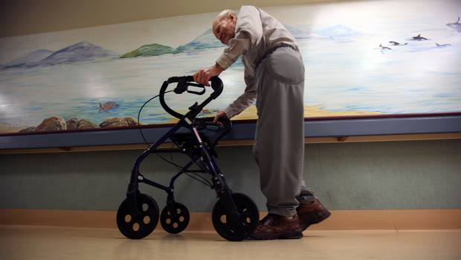
What do we know about enablers and barriers to hip protector use in LTC and in the community?

Slide 26
Factors facilitating use in LTC
System characteristics
Organizational commitment
Staff education
Provision at no cost
External source support
Korall et al. JAMDA 2015; 16:185-93.
Notes:
Factors identified as increasing acceptance and adherence in LTC – as identified by a systematic review
System level characteristics
Facility commitment to a hip protector program
Structured education on hip protectors and provision of garments at no cost.
Support from external sources. In 3 studies, ongoing support from external agencies, such as general practitioners and quality and safety boards, emerged as a system-related incentive for acceptance and/or adherence

Slide 27
Factors facilitating use in LTC
Staff characteristics
Commitment to work with protectors
Positive attitudes
Korall et al. JAMDA 2015; 16:185-93.
Notes:
Caregiver/ staff level characteristics:
Positive attitudes regarding the effectiveness of hip protectors.
Staff commitment to work with hip protectors.

Slide 28
Factors facilitating use in LTC
Resident characteristics
Clinical risk factors for falls and fractures
Recognition of need
Use of incontinence products
Physical and cognitive impairment
Peer & family advocacy
Positive attitudes
Korall et al. JAMDA 2015; 16:185-93.
Notes:
Resident level characteristics:
Clinical risk factors for falls and fragility fractures
Recognition of the need for hip protection
Positive attitudes regarding the effectiveness of hip protectors
Peer and family advocacy for use
Wearing of incontinence materials – associated with increased acceptance and/or adherence compared to those who do not.
Physical and mental disability – increased acceptance and/or adherence were cognitive decline consistent with dementia, memory impairment, restricted mobility (with the exception of wheelchair use), and the need for moderate assistance with activities of daily living.

Slide 29
Factors facilitating use in LTC
Hip protector characteristics
Soft shell type
Colour steadfastness
Korall et al. JAMDA 2015; 16:185-93.
Notes:
Hip protector characteristics:
Color steadfastness - consensus among certified nurse assistants that tan or beige, neutral colored garments were the most likely to be accepted and continuously worn, as they were least likely to fade, discolor, or tinge. Certified nursing assistants believed that residents would be dissuaded from continuing use if garments became stained or discolored after washing with chlorine.
Soft shell hip protectors – adherence higher for soft shell vs hard type, especially at night. More soft shell users were 24 hour users than those who wore hard protectors.

Slide 30
Barriers to use in LTC
System characteristics
Laundering issues
Insufficient staffing
Communication breakdown
High leadership turnover
Korall et al. JAMDA 2015; 16:185-93.
Notes:
Barriers to use in LTC – as identified by a systematic review
System level characteristics
Laundering issues – clean hip protectors not always available when needed, those with incontinence require frequency laundering. Additional – anecdotal: damage or loss in laundry, some can only be laundered a specific number of times before they need to be replaced.
High leadership turnover – greater adherence with fewer management changes
Insufficient staffing, which creates excessive workload
Communication breakdown at the frontline – not documented in care plans, aides not aware or didn’t understand benefits.

Slide 31
Barriers to use in LTC
Staff characteristics
Clash with residents rights to autonomy
Negative perceptions
Korall et al. JAMDA 2015; 16:185-93.
Notes:
Caregiver/ staff level characteristics:
Negative perceptions of hip protectors: concerns about hygiene, cost-effectiveness, maintaining dignity of residents, side effects (pressure damage, redness of skin), amount of effort to don and doff; perceived as time-consuming and stressful by night staff.
Perceived clash with residents’ rights to individual choice and autonomy - difficulty understanding a residents’ decision to wear hip protectors. In some situations, staff made the decision not to offer hip protectors because they perceived they would have been forcing residents to wear the garment against their will and were dedicated to upholding their rights’ to individual choice and autonomy.

Slide 32
Barriers to use in LTC
Resident characteristics
Socioeconomic disadvantages
Fatalism and depression
Use of incontinence products
Physical and cognitive impairment
Prioritization of other care needs
Persistent incontinence
Korall et al. JAMDA 2015; 16:185-93.
Notes:
Resident level characteristics:
Social or economic disadvantages – lower compliance in non-whites, migration backgrounds and the receipt of welfare assistance.
Fatalism and depression – view of end of life, depression, or other mood symptoms associated negatively with acceptance and/or adherence.
Persistent incontinence - the relationship between incontinence and compliance was mediated by the frequency of incontinent episodes, where persistent urinary and bowel incontinence were identified as a potential barrier to acceptance and adherence. In the observational study, a greater proportion of residents who declined hip protectors (39%) vs accepted (27%) were always incontinent (P < .001). In another study there was less adherence among residents who were always incontinent of the bowel than among those who were always continent (P < .01).
Prioritization of other care needs because of illness – or a significant change in condition or decline in functional status. A deterioration of health resulting in nonambulatory status was encountered as a reason for noncompliance

Slide 33
Barriers to use in LTC
Hip protector characteristics
Discomfort
Side effects
Distaste
Relative complexity
Korall et al. JAMDA 2015; 16:185-93.
Notes:
Hip protector characteristics:
Discomfort – usually associated with hard protectors, often arises from poor fit (too small, too tight) or bulkiness.
Side effects – aches and pains, swelling, itchiness, skin irritation (heat rash, redness
Distaste – issues with style or appearance; makes them look unattractive, especially if there are unsightly stains, discolouration.
Relative complexity – difficulty donning and doffing, if they lose previous independence by now requiring assistance for dressing and toileting. Arthritis exacerbates difficulty using hip protectors.

Slide 34
Community-dwelling older adults: Factors facilitating use
Positive beliefs about benefits
Comfort
Fit
Convenient to don and doff
  Minimal interference with activities (toileting)
  Minimal maintenance issues (easy to launder)
Perceived protection
Appearance
Cianferotti et al. Calcif Tissue Int. 2015; 97(1):1-11.
Blalock et al. Injury Prev. 16:23-39.
Notes:
Similar enablers identified in LTC have also been identified among community dwelling adults. Comfort, convenience, and fit were most frequently identified factors in the Blalock 2011 study

Slide 35
Community-dwelling older adults: Barriers to use
Low self-efficacy
Fair to poor-rated health
Problems with correct positioning
Incontinence or increased dependency in toileting
Perception of low fracture risk and effectiveness
Adverse events: skin irritation, abrasion, discomfort
Reduced quality of life with use
Gender – men less likely to be offered use
Cianferotti et al. Calcif Tissue Int. 2015; 97(1):1-11.
Cameron et al. 2011. Osteopor Int. 2011;22(2):617-26.
Notes:
Similar barriers identified in LTC have also been identified among community dwelling adults

Slide 36
Does adherence vary based on type of hip protector?
Hard pads
Soft pads
Blalock et al. Injury Prev. 16:23-39.
Notes:
Does adherence vary based on type of hip protector (hard or soft, brands)… not really!
In a study comparing hip protector brands, the number of hours the hip protectors were worn ranged from 92.5 for SafeHip to 65.2 for HipGuard – both the highest and lowest times were for hard pad brands. Hipguard and Fallgard – one being a soft pad and the other a hard pad, were used less than the other two brands. Looking at the different characteristics of the hip protectors (comfort, appearance, protection, fit, convenience) – mean ratings didn’t really vary much between brands or types, though the use of the hip protectors was positively corelated with the various characteristics. The intention to continue using a particular hip protector after the study ended was significantly associated with the number of hours the hip protector was worn during the study (p<0.01) – they more they were worn during the study, the more likely people were to continue using them. In further analyses, after controlling for other variables, beliefs concerning the amount of protection that a hip protector provided was positively associated with the number of hours the hip protector was worn during the study (p<0.05) and the intention to continue using the hip protector after the study (p<0.01). So beliefs that wearing the hip protector will reduce fracture risk is important to adherence and this was independent of the type of protector that is being used in this study, but more research is needing comparing different types of hip protectors.

Slide 37
Strategies to improve adherence
Provide opportunity to select and try different products
Provide hip protectors at no cost
Ensure proper fit
Encourage selection of hip protectors with documented protective effect
Design/ create hip protectors to be:
  Comfortable (airy, light, breathable)
  Easy to take on and off
  Aesthetically pleasing
  Tailored to gender-specific tastes
Education (risk factors, need, benefits)
  For leadership, staff, older adults, family
  Older adult peer or family educators
Korall et al. JAMDA 2015; 16:185-93.
Cameron et al. Osteopor Int. 2011;22(2):617-26.
Notes:
Strategies to improve adherence – LTC and community. Generally, there are few RCTs looking at specific interventions to improve adherence as a primary outcome, but some studies do exist that provide some insights on how to improve adherence.
To overcome hip protector level concerns, residents should be given the opportunity to select and try on a variety of models to maximize potential for proper fit.- try both hard and soft shells.
Not all hip protectors are equally effective, so residents should be encouraged to select from hip protectors with documented protective effect.
Designers and engineers should direct their efforts to creating garments that are more comfortable (airy, light, breathable), easy to take on and off, especially for those with arthritis, and aesthetically
appealing with designs tailored to gender-specific tastes; differentiate the front and back sides of garments to facilitate proper application, using snaps or Velcro for fastening, and selecting neutral colored fabric.
Education - to increase client (family, friends, residents) awareness of risk factors for falls, risk factors for fall related hip fractures, and the potential benefits associated with protector use. education programs
enlist older adult peer educators and/or family to facilitate knowledge transfer and exchange.

Slide 38
Patient Education Tools
http://agingisacontactsport.com/
https://patienteduc.fraserhealth.ca/file/hip-protectors-always-on-your-side-481.pdf
Notes:
Lots of patient education tools on-line. Here are two examples – video put out be Aging is a contact sport – they have a number of tools to support patient education. Another is a pamphlet created by Fraser Health (BC) on what they are, how they work and how to calculate the right size and fit.

Slide 39

Proper selection
CSA: Labelling should include:
Instructions proper positioning
The number of times it can be cleaned and disinfected (maximum = 30 times)
Single individual use or institutional use (after cleaning and disinfection).
Warnings of issues with use with other medical devices.
Single impact or multiple impact use.
Protective value.
www.CADTH.ca
Notes:
Patients should select the most appropriate type of hip protector based on their needs and scrutiny of product labels.
Canadian Standards Association – overview the labelling and testing of hip protectors – things to consider when selecting hip protectors. CADTH document on buying and care instructions: buying_and_care_instructions_for_a_hip_protector_e.pdf (cadth.ca)
Protective value is how much the hip protector reduces the force during a fall – number between 0 and 100; the larger the number the greater the protection.

Slide 40
A final word about fracture prevention
There is no single solution to preventing fractures
Methods dependent on fracture risk
Need multi-factorial interventions
  Fracture risk assessment
  Environmental adaptations
  Patient education
  Resistance, balance and functional strength training
  Hip protectors
  Vitamin D and calcium supplementation
  Bone-strengthening medications
  Life-style changes (nutrition, no smoking, ↓ alcohol)

Slide 41

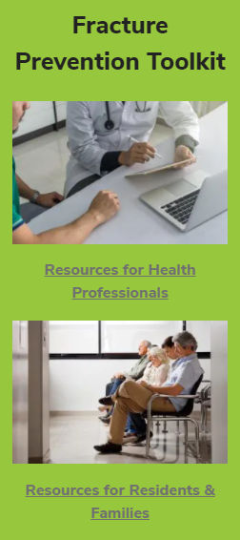

Fracture Prevention in LTC
Notes:
Go to the GERAS.CA or simply Google “Fracture Prevention Toolkit” and you will find the GERAS Centre website on Osteoporosis – here you will find a toolkit with information on the Fracture Risk Scale, fracture prevention guidelines, tools and resources to support the implementation of the guidelines , videos on osteoporosis, resident experiences with osteoporosis, and exercise programs to prevent fractures.
All of these tools are easily accessible and free to download.

Slide 42


